Slide 1
ARI2201 – IAPT Presentation
Autonomous maltese wordle solver
Nathan Bonavia Zammit – 0198402L

Slide 2
Main Goals
The main goal of the assignment was to build a program which could autonomously play a Wordle game – in the Maltese language.
To cater for the fact the solver needed to be in Maltese, 2 Wordle Clones were considered
Werdil,
Kelma.mt
Werdil was chosen for the final build.
Accessing the website’s elements was done through Selenium.

Slide 3
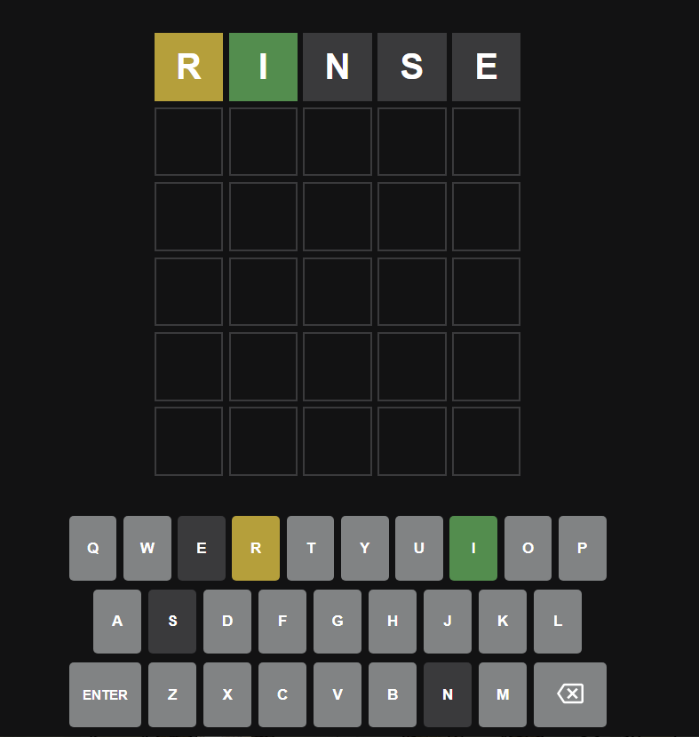
What is Wordle?
Wordle is a simple game which involves the user inputting 5 letter words.
The game shall then return feedback of the user’s guess:

Slide 4
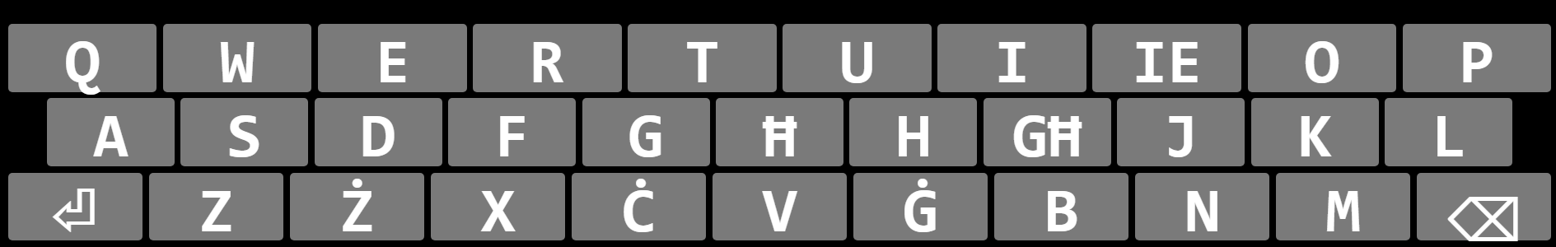
Why Werdil?
Due to Wordle’s popularity there are a large number of wordle clones.
Kelma.mt and Werdil are two Maltese Werdil clones.
Werdil caters for special Maltese letters such as IE and GĦ.
A link to the game can be found here: https://wordle-malti.github.io/

Slide 5
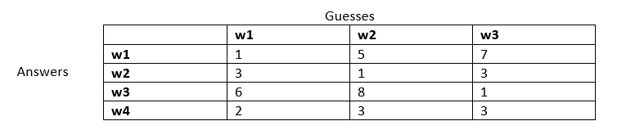
Algorithm Used
The program decides on what letter to use based off of the feedback given from the game.
It does so via a matrix which then decides on the next pick via the Best Worst Case Scenario.

Slide 6
Thank you for your time

